Slide 1

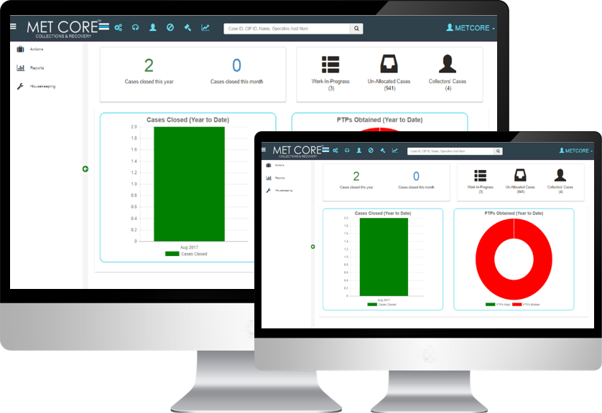

RC: 1031898
METCORE™ Retail Loan Collections System

Slide 2
Content
1.
Why METCORE: About Metzger Limited
2.
Context: Business Challenge
3.
Our Solutions
4.
Collector Competitive Landscape
5.
Technical Information
6.
Value Proposition
7.
Next Steps
RC: 1031898

Slide 3
About US

Slide 4













METCORE: Pioneer Ingenious Collections Solutions
Mission Statement
‘to increase possibilities for our clients’ and expand their horizon by strengthening their ability to compete and adapt to changes through innovative, value-adding and systematic changes to their business model, processes, practices and people structure’
Focus and Expertise
Team of seasoned bankers and banking technology professionals with over 50 years quality experience across banking and professional services industry geared towards managing your corporate risks.
Application suites targeted at work productivity problems at Enterprise and SME level.
Capabilities covering Collections, Analytics and Business Intelligence.
Accredited member of the Chartered Institute of Personnel Management (IPM)
Accredited member of the Chartered Institute of Management Consultants (IMC)
Our Clients
Our Partners
Accreditations
RC: 1031898

Slide 5


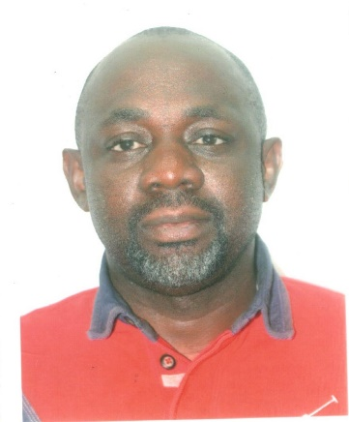
Our Team
Bayo Shonibare
Managing Director
Adebayo Ogunnusi
Director
Poyepo Simoyan
Director
>20 years experience spanning Management Consulting and Banking.
Prior Experience: Assistant Vice President (Assistant General Manager) and Head of Business & Operational Risk Management in FCMB Plc, Risk Management at Accenture, Consultant at Phillips Consulting Limited
Subject Matter Expert (SME) in Enterprise Risk Management, Credit/Operational Risk Management, Lending Transformation, Basel II Implementation, Business Process Re-engineering, Strategy, Business Plan Development and Feasibility Studies, Project Management, Human Resource Management and Enterprise Performance Management
>17 year experience across Management Consulting and Banking
Prior Experience: Former Group Head of SME at Heritage Bank, Consultant at Phillips Consulting Limited, Group Coordinator at First City Monument Bank Plc, Financial Controller at Bank PHB (Now Keystone Bank Limited), Financial Control Officer at Access Bank PLC and Technical Adviser to the Honorable Minister of State for Finance in 2008.
Subject Matter Expert (SME) Entrepreneurial Development, Project and Infrastructure Finance, and Financial Advisory.
Holds a Master's degree in Finance from the prestigious London Business School
>17 years experience spanning Management Consulting, Financial Advisory, Investment Banking and Power Project Development.
CIMA certified Business Accountant
prior work experience: Project Development & Investment - General Electric, Project Finance - UBA Capital, Infrastructure Finance - Renaissance Capital, Corporate Finance - KPMG, Finance & Performance Management – Accenture, Management Consulting - Phillips Consulting Limited
RC: 1031898

Slide 6
Business
Challenge

Slide 7
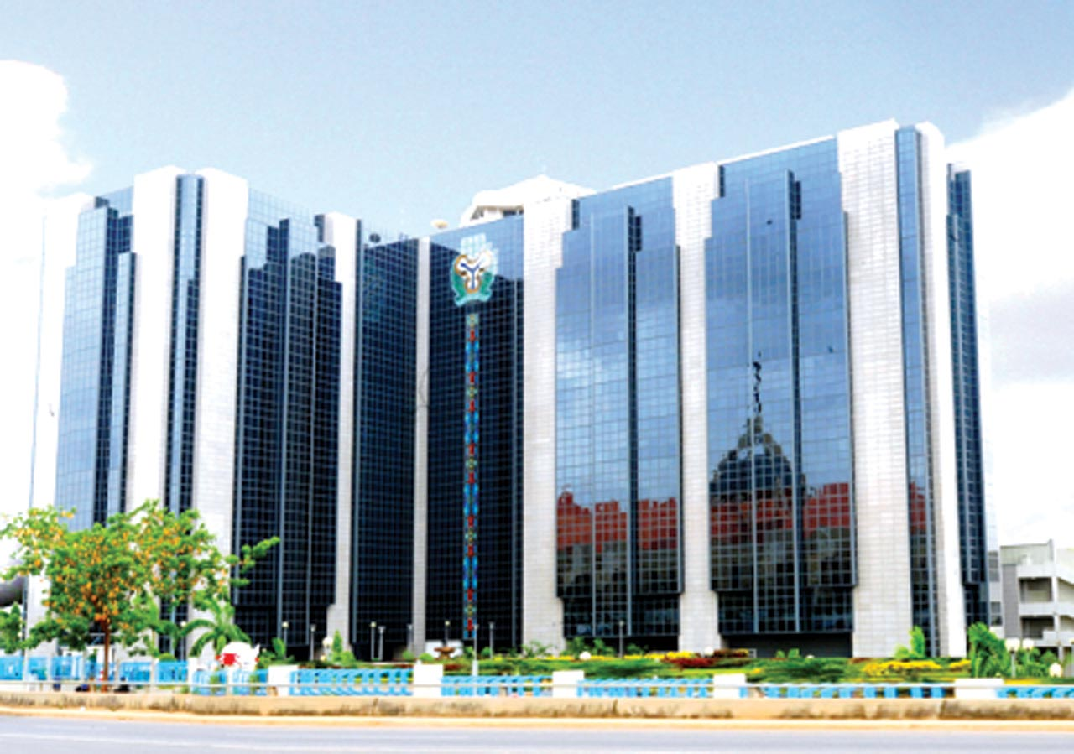


Business Challenge
Nigeria’s Debt Profile as of Q3 2017
Nigerian financial service providers shoulder large unpaid debts from defaulting consumers and businesses.
Large uncollected debt has a deleterious effect on the availability and cost of credit-based services
Credit providers are likely to scale back offerings or increase interest rates on credit-based services to offset financial losses from borrower defaults.
Consumers suffer as credit opportunities become less available and more costly; this can lead to reduced consumer spending, which directly affects economic productivity.
Internal
$51.28 billion
External
$15.35 billion
Total
$66.63 billion
$%b
$10b
$20b
$30b
$40b
$50b
$60b
$70b
$80b
N360 : $1
Source: DMO
2.084tn
# non-performing loans (Q4 2016)
Bad Loans
14%
#non-performing bank loans to gross loan ratio (Q4 2016)
Source: CBN
RC: 1031898

Slide 8


Business Challenge
Credit Risk is the potential that a bank borrower will fail to meet its obligations in accordance with agreed terms
Foreign Exchange
Market Risk is the risk of losses in on-and-off-balance-sheet positions arising from movements in market prices
Interest Rate
Equity
Bank
Operational risk is the potential loss resulting from inadequate or failed internal processes or systems, errors, or external events
Commodity
Which of these risks poses the greatest long-term threat to a financial institution?
CREDIT RISK!!!
RC: 1031898

Slide 9
Business Challenge
Challenge 2
Challenge 3
Collections departments are challenged with minimizing losses and controlling costs while delivering a sensitive service experience that retains valuable customers.
Manual tasks and disjointed collections systems lack the intelligence and agility needed to instantaneously deliver customer-centric experiences, increase collections success rates and reduce costs.
Challenge 1
The bank and customer relationship is premised on an irrebuttable cordiality, with a give and take understanding. Often, this relationship is strenuously tested during loan/debt recovery processes.
Challenge 4
Fluctuating lending volumes, changing credit risk dynamics, and high average system age are increasing demand for retail loan collections systems.
RC: 1031898

Slide 10










Business Challenge: Collections Cycle Overview
Due
Not Contacted
Indicate Outcome or Reason e.g. phone switched off, busy
Contact debtor
Calls
SMS
Emails/Letters
Contact Next of Kin
Loan Contract agreed
Debtor Details:
Name
Personal Details
A/C No
Amount Agreed
Next of Kin
If date not due
PTP
Promise to Pay
YES
Payment honored?
Close Case
Send Reminders
SMS
Emails
Letters
Raise Issues
NO
Amount disputed
Debtor not aware
Restructuring
Escalate to Collections Department
Implement Collections Software/Technology?
Check for Debt Class
RC: 1031898

Slide 11




Solutions: simplifying the debt collection process
Reduce Agent Contact Rates
Automated programs offer plenty of data within their systems, which allows collectors to be “more responsive” to customers during meeting calls.
Customer satisfaction improves when utilizing an automated system, as the reduction of contact rates would lead to more productive interactions between client and collectors.
Ensure Best Practice & Compliance
Implementation of an Automated Collections Workflow would ensure standard levels of compliance is maintained across all processes.
Makes it possible to implement a “best practice” approach, thus reducing variations and avoiding potential legal problems.
Automate Collections Process
Automation of the collections process would lead to the reduction in agent service times and human error.
Routine tasks such as issuing demand letters, scheduling appointments can be issued at targeted and preset times
Reduce bad debt and improve the cash flow while optimizing the collection cost.
Historical Reporting
Capability to review and analyze strategies and collections data.
Critical when deciding champion strategies or altering collections workflow
Analysis and reports can be utilized when constructing champion strategies; thus improving the collections process
RC: 1031898

Slide 12
The solutions are clear The challenge is not identifying what needs to be done The challenge is execution: Getting It Done!

Slide 13
our
solution

Slide 14
A Modern Approach
Today’s larger debt management landscape needs a new approach. That’s why METCORE focuses on:
Leverage Predictive Analytics to Maximize Collections and Minimize Risk
Balanced workload and optimized resources, both internal and external.
Advanced user experience and workflows to increase workforce productivity.
Score cards are used to generate forecasts of future customer behavior.
Data & Data Cleansing
KNOWING
Your Customers
INTERACTING
With Your Customers
Analytics & Data Intelligence
Workflow Management
UNDERSTANDING
Your
Customers
TARGETING
Your
Customers
Strategy & Segmentation
RC: 1031898

Slide 15
“METCORE™ Recovery Loan Collection System (RLCS) is a unified debt management system of personalized, dynamic case management, best practice, business rules-driven automated processes, and real-time decisioning to help resolve debts, accelerate collection rates, retain valuable customers and reduce the number of contacts needed to drive cases to resolution while ensuring compliance and reducing operational costs.

Slide 16
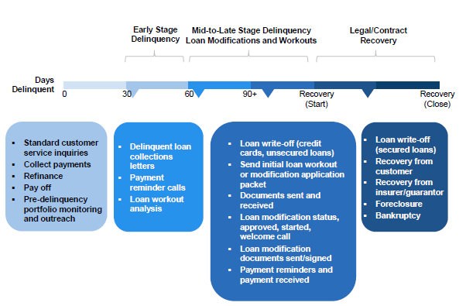
Our Solution: Recovery Process
RC: 1031898

Slide 17
METCORE™ provides for Efficient and Effective management of Collections Data. This package has extensive (industry) field-testing and has been enhanced intuitively to meet user needs and to support technical and non-technical users.

Slide 18



Our Solution: Workflow Process
DATA ENTRY
FIELD COLLECTORS
CASE CLOSED
Debt Data entered in METCORE Database for processing
Follow-up Notice
Visit Customers home, place of work to retrieve PTP funds
Case closed and records expunged from system
TELE-COLLECTORS
LITIGATION
Send Dunning Letters
Emails/SMS reminders
Contact Customer (phone calls) and log interactions
Ultimatum Notice
File lawsuit against customer
Court order Repossession and, or awards damages
METCORE RLCS
MIS Dashboard, Reports & Analytics
RC: 1031898

Slide 19
The METCORE™ Audit Trail insures data integrity for users and their clients. This increases confidence in billing accuracy.

Slide 20
METCORE™ Rule-Engine is used to produce triggers at early stages, to impose Pre-collection (proactive), aiming to convert risks to opportunity.

Slide 21
Product Development Timeline
APP DEVELOPMENT
MVC REDESIGN
METCORE DEVELOPMENT
MetCore development commences, with implementation In Microsoft SharePoint
Development began on RLCS application implemented in Microsoft SharePoint.
Application re-engineered in .NET MVC to enhance user experience and
2014
2015
2017
PRODUCT RESEARCH
CLIENT DEPLOYMENT
ENHANCED FEATURES
Research analysis into industry gaps and requirements
Application deployed in client bank’s Collections Department
Analytics and Intelligent actions integrated to increase workflow efficiency
RC: 1031898

Slide 22

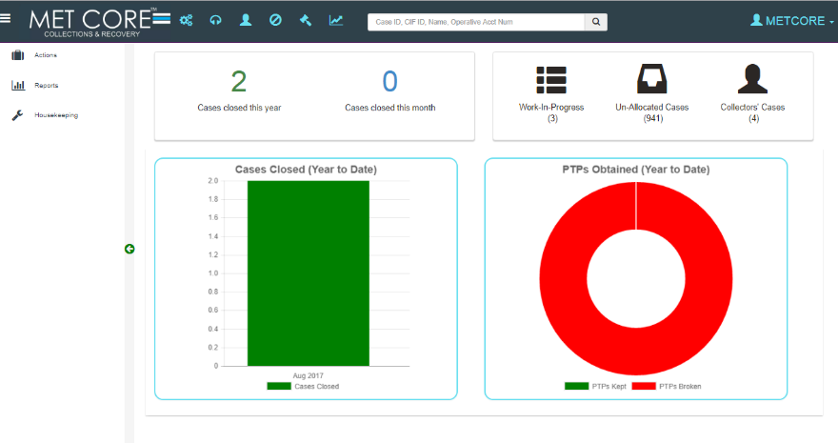




METCORE™ Recovery Loan Collection System (RLCS)
Configurable Autonomous Workflows
Workflow Plans streamline all key collections processes (Telephone and Field), including pre-collections and legal debt recovery actions.
Best Coding & Design practices
Implementation of standard industry techniques involving Regular Refactoring, Debugging, Test-Driven Development, and Continuous Integration.
Adaptive Analytics & Reports
Predictive analytics and adaptive decision management anticipate needs, recommending the next best action, contact outcome or suggest relevant contact outcomes to collectors in real time.
RC: 1031898

Slide 23
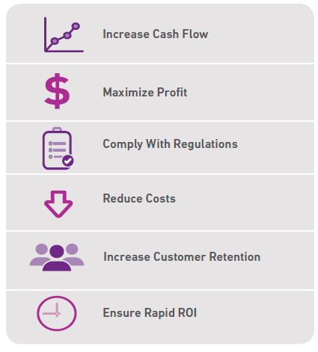
METCORE: Features & Benefits
Workload Management Daily Management of work queue assignments. Workload Balancing
Automation Automate collection strategies, customer contact and queue workloads
Higher Agent Productivity Transform, Streamline and Automate Collections Management Processes
Reporting Dashboard & Analytics Built-in standard reports and dashboards leverage Predictive Analytics to Maximize Collections and Minimize Risk
Faster ROIs Higher Success Rates and Higher revenue from Collections
Metrics Set track and collection goals
Waiving Charges Option to waive off charges on borrower’s loan or lease
Contact Preferences Configure borrower’s contact preference, preferred channel of communications
Contact Templates Setup message templates for emails, SMS, and letters
Documentation Record customer interactions including promise to pay, emails and dunning letters
Batch Jobs Create automated collection jobs to set reminders, run automated collection activities, confirm PTPs, queue loans and manage workloads
Tracking Automated tracking of delinquent contracts, undelivered correspondence and promises made
Service-oriented Architecture CL Collections is architected for easy integration to core lending systems, dialers, SMS and email systems
Consistency Ensure Standardization and Compliance across all stages
Key Benefits
RC: 1031898

Slide 24
technical
information

Slide 25















Platform Overview
Browser Interoperability
File Export Formats
Data Sources
Mobility
Email Clients
Source Systems
METCORE RLCS CORE
DB LAYER
CLIENT VIEWS
METCORE Desktop Client
Rule-Based Queue Management
Strategy Management
Business Rules Configuration Engine
Repossessions
Internal Litigators, Repossessions
Collections Scoring
User Management / RBAC
Collections Supervisors
Tele/Field Collectors
METCORE RLCS
(Azure, AWS)
Core Banking
Parameterized Workflow Processing
Risk Managers
Others
Security
Audit Trail
Analytics
Data Security
Application Security
Application Server Log (Elmah)
Database Server Log
MIS REPORTS & DASHBOARD
Client View
RC: 1031898

Slide 26


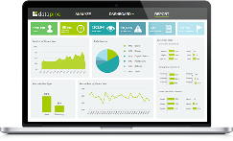



Solution Architecture II
Source Data
Data Integration Layer
Data Storage
Reporting & Analytics
Data Extracts
Staging Area
Bank/Client DB
EDW
External Data
Compliance/ Auditory Reporting
Daily Scheduled tasks
Transformed through Views
ETL Processing at Close of Business
Other
Sources
Predicative Business Analytics
+
Summary data
Meta data
ODS
Raw data
Collections Behaviour Scoring
Unstructured data
Data Integration, Transformation and Loading
Data Model
Strategy Management
System Generated
Any OS
Any DB
Any OS
Any DB/Sysbase
Any OS
Any App Server
Met Core Staging Data Model
Met Core Data Model
Business Objects
RC: 1031898
Cloud Storage

Slide 27
Data Integration Architecture
Data Sources
Core Banking
Web Services /Middleware:
XML, CSV, Excel
Database
SQL Server
Back-end Integration
Data Load: ETL at close of business
Staging Database
Customer Information
Collateral Information
Limits & outstanding balance
Static data
Data and Column Mapping
Interface
Decline Data
Forward Data
METCORE Data Warehouse
Metadata Data
RC: 1031898

Slide 28
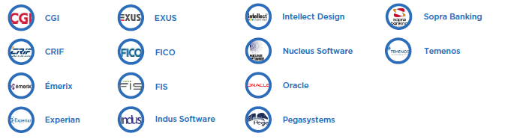
Enterprise Collections Competitive Landscape
Global Industry Heavyweights
Indigenous Solutions
MetCore
RC: 1031898

Slide 29


Enterprise Collections Landscape for Banking
37%
FINACLE 7/10 (Access, Citibank, Diamond, Ecobank, Skye, Union Bank)
Finacle is a complete suite of banking application from Infosys, one of the largest technology companies in India.
32%
FLEXCUBE (Fidelity, FCMB, Heritage, Stanbic IBTC, UBA, Wema, First Bank)
From Oracle Financial Services. It is highly regarded globally with about 700 installations in 125 countries.
16%
Basis & Banks (GTB, Sterling, Unity)
Basis and Banks are from ICS Financial Services, a midsize Jordanian/UK software company with about 45 installations worldwide.
15%
Others - Phoenix, T24,eBBS (Keystone, Standard Charterd, Zenith)
Temenos T24, Phoenix Systems snd eBBS 24-hour real-time banking application that provides multiple application server support to a number of users.
Banking Suite Software deployed by Major Nigerian banks, have Loan Repudiation, Issuing And Management tools integrated within their Core banking Applications. However, after a loan is categorized as ‘bad debt” (i.e. non-performing) and recorded as a net loss at the end of a fiscal year, there is a genuine lack of specialized software to assist Collections Department pursuing bad loans.
RC: 1031898

Slide 30
Dashboard, workflows & reports

Slide 31
Workflows
Workflow
Super Admin
Access to all available workflows
IT Admin
System Administration workflow
Internal Control
System Administration workflow
Business Admin
System Administration workflow
Tele Collector
Tele-Collector workflow
Field Collector
Field-Collector workflow
Recovery
Repossession workflow
Litigation
Litigation workflow
Report
MIS Dashboard workflow
Description
Access Levels
Supervisor
View
Edit
User
View
View
View Only
Input
Assign
Edit
Input
Close Case
Close Case
Users are assigned to a workflow and issued access level permissions to view, edit or manage functions across the system.
RC: 1031898

Slide 32
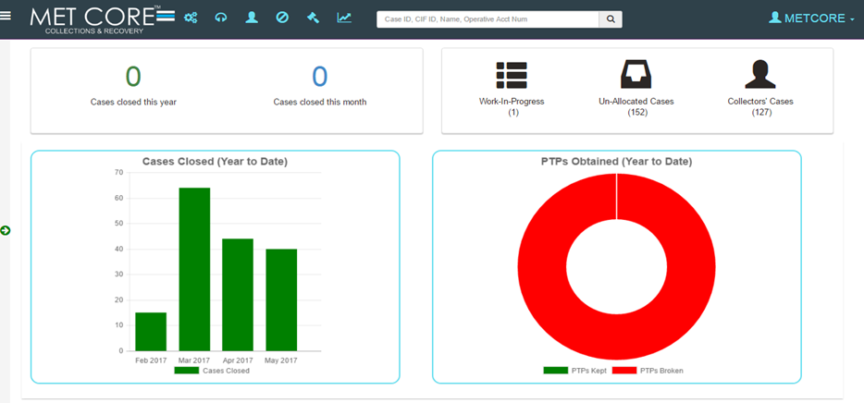
METCORE: Dashboard, Workflows & Reports
Collector Dashboard
User’s custom dashboard, indicating cases closed and current tasks
RC: 1031898

Slide 33
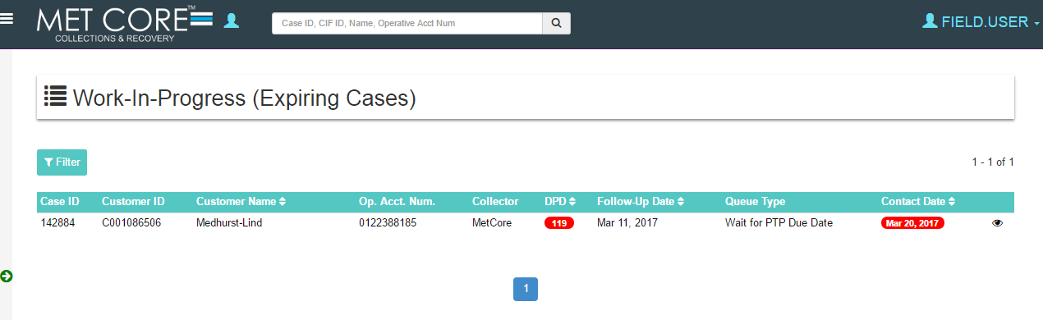
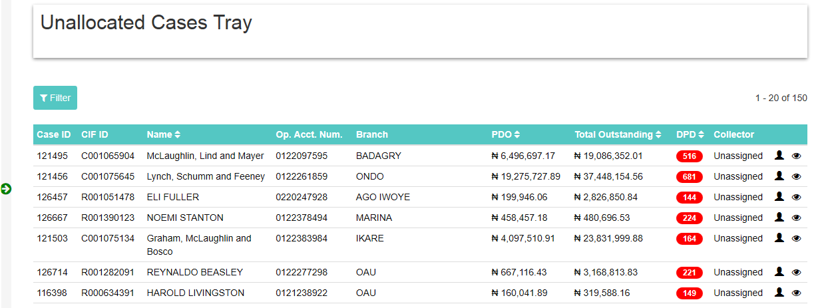
MetCore: Dashboard, Workflows & Reports
Work In Progress
Displays user’s current tasks
Unallocated Casesⁱ
Displays cases not yet allocated by a Supervisor
ⁱApplicable to only a Supervisor role
RC: 1031898

Slide 34
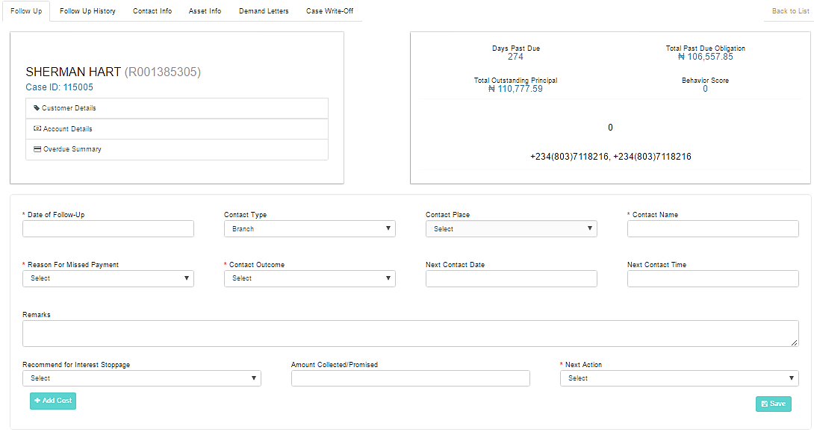
MetCore: Dashboard, Workflows & Reports
Case
Follow Up
Follow-up screen to detail every interaction between a customer and collector after a collection run
RC: 1031898

Slide 35
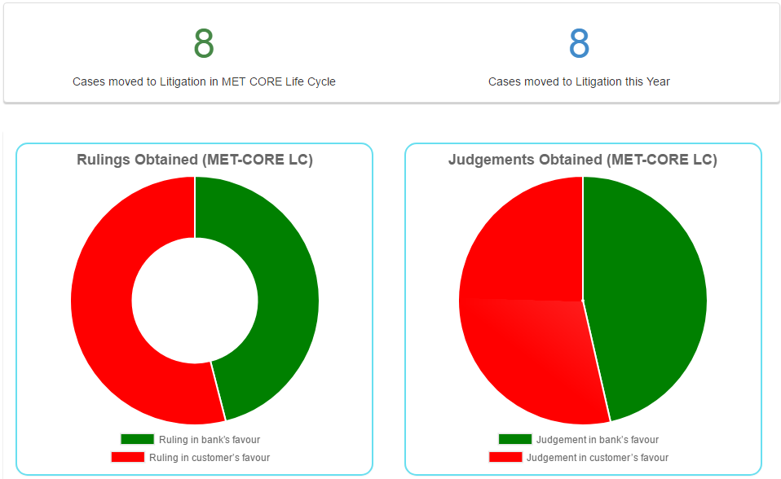

MetCore: Dashboard, Workflows & Reports
Litigation Dashboard
User’s custom dashboard, indicating rulings and judgments obtained
RC: 1031898

Slide 36
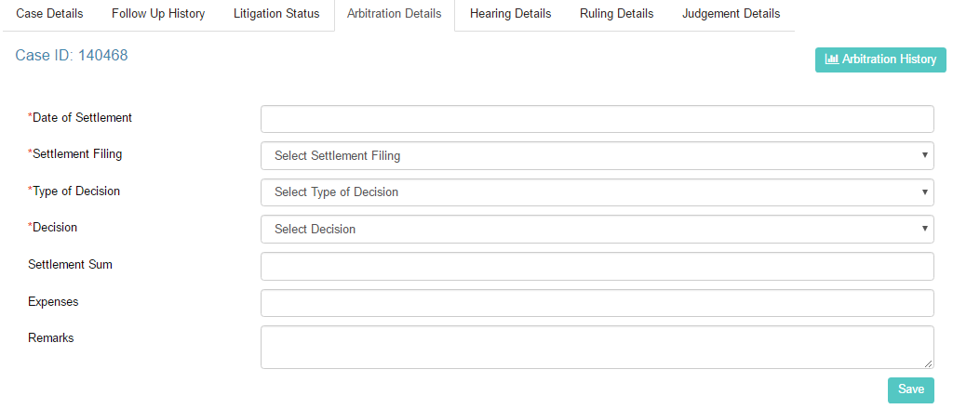
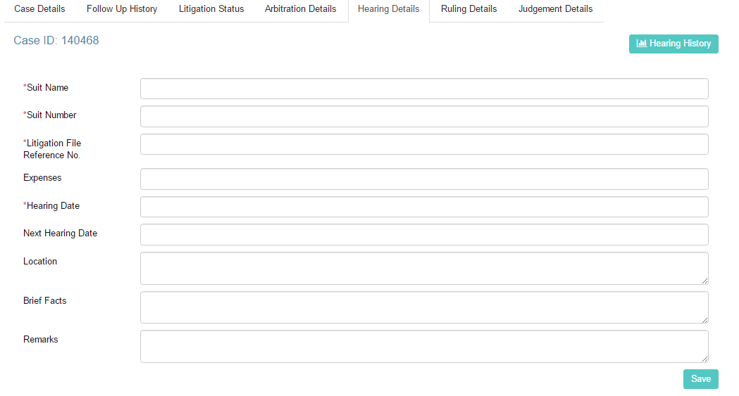
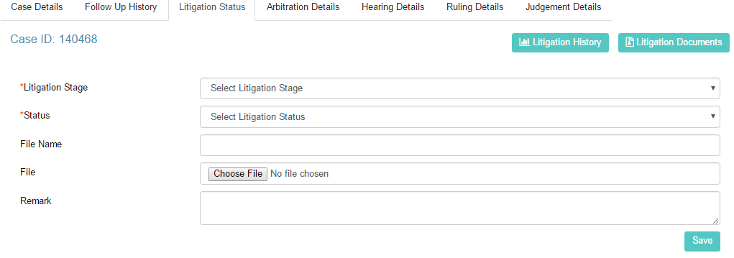
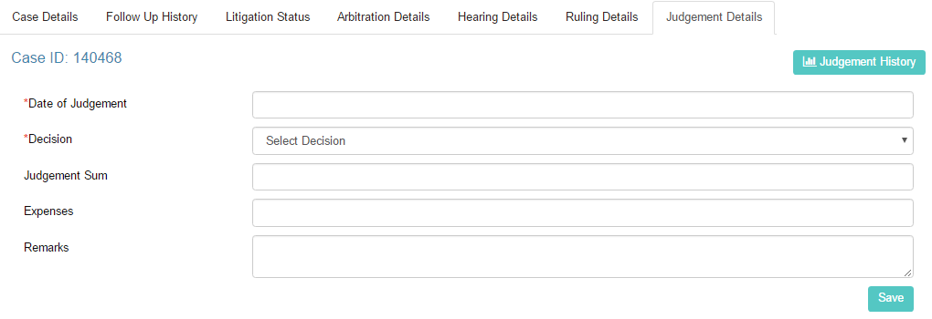
Met Core: Dashboard, Workflows & Reports
Litigation
Follow Up
RC: 1031898

Slide 37
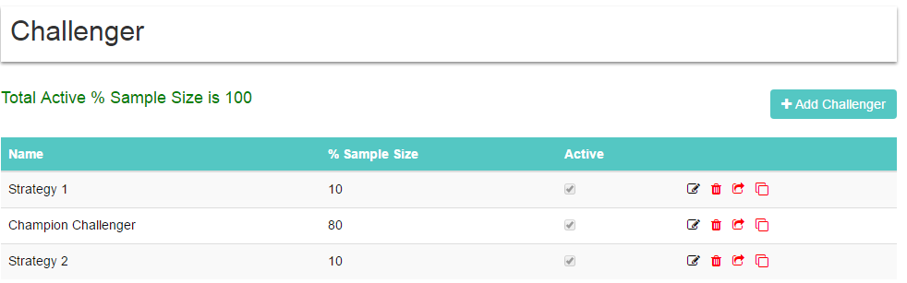
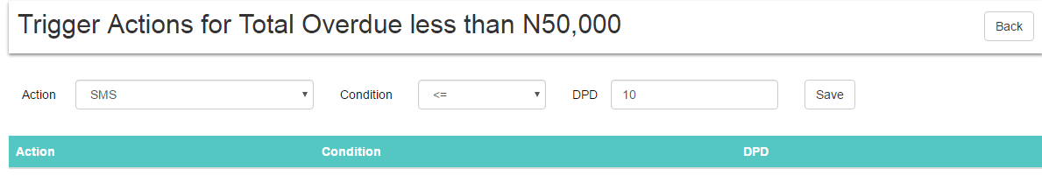
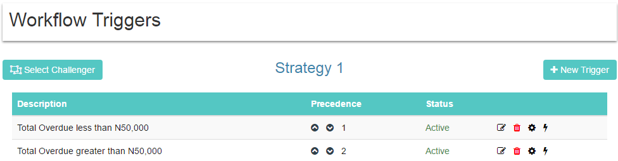
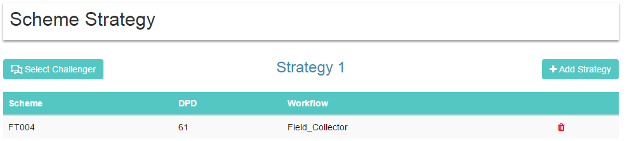
Met Core: Dashboard, Workflows & Reports
Challenger, Workflow Triggers & Scheme Strategy
Challengers | Manage Champion and Test Strategies
Workflow Triggers | Case Workflow Process Management
Scheme Allocation | Allocates Strategy to a particular collector group
RC: 1031898

Slide 38
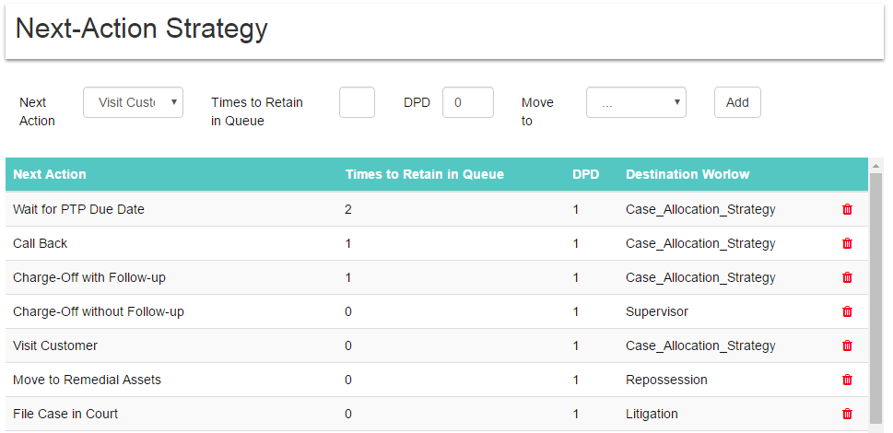
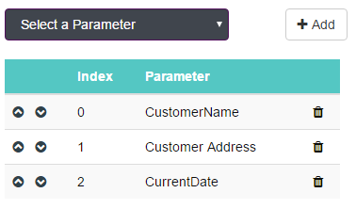
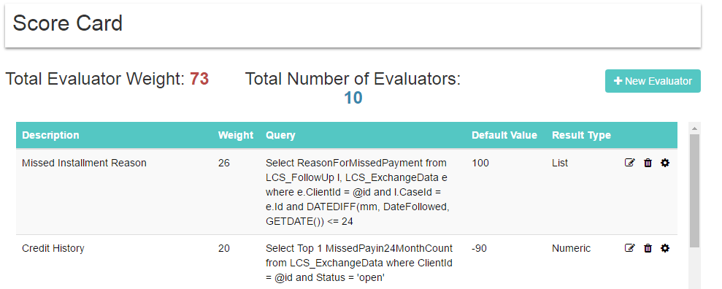
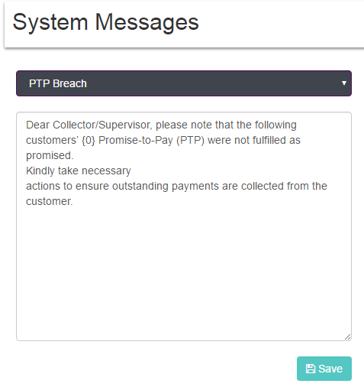
Met Core: Dashboard, Workflows & Reports
Strategy, Score Cards & System Messages
Next Action | Triggers Next-Action after a strategy has been fulfilled
Score Cards | Create & Manage Behaviour Scoring Rules
System Messages | Configure & Manage case alert notices and messages (Email/SMS Reminders)
RC: 1031898

Slide 39
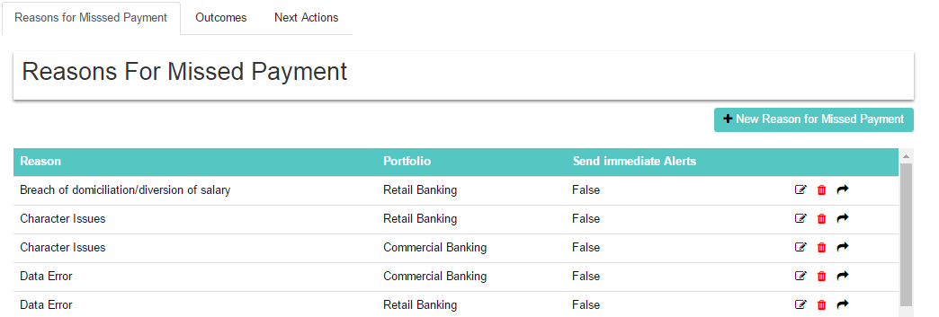
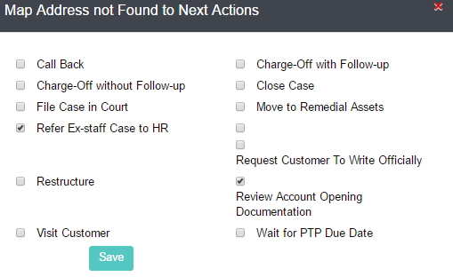
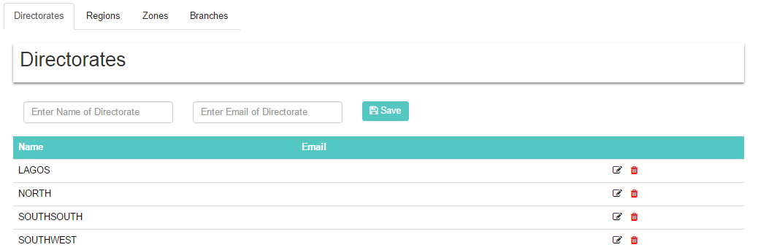
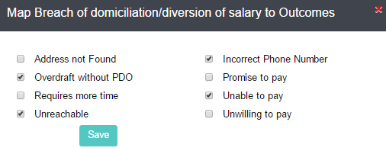
Met Core: Dashboard, Workflows & Reports
Reasons for Missed Payment, Directorate & Mapping
Reasons for Missed Payment | Configure & Map anticipated reasons after an unsuccessful collection run
Directorates | Manage Directorates/Regions handled by System
System Messages | Configure & Manage case alert notices and messages (Email/SMS Reminders)
RC: 1031898

Slide 40
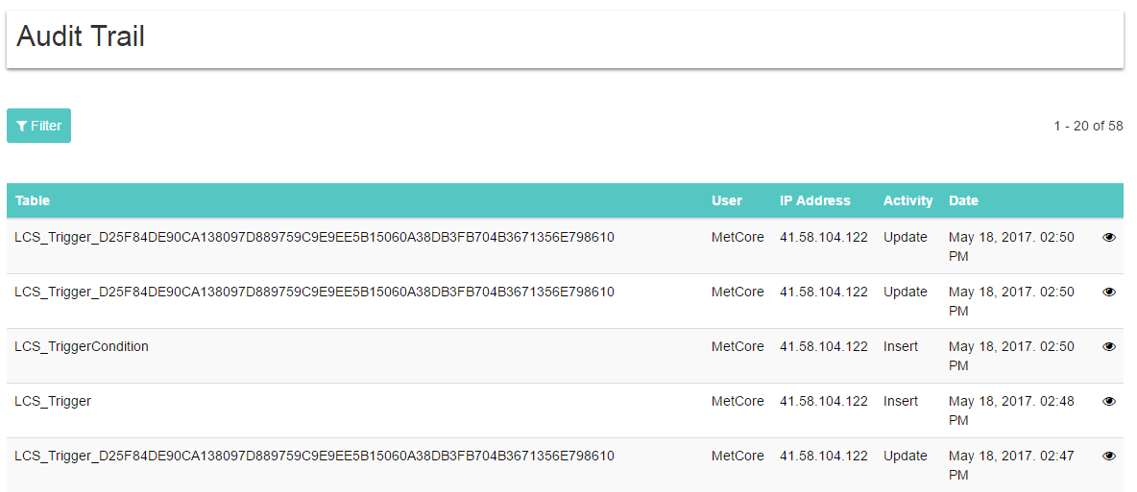
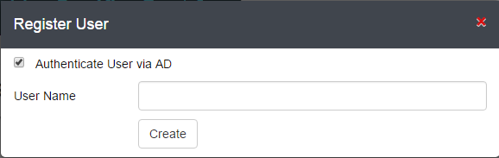
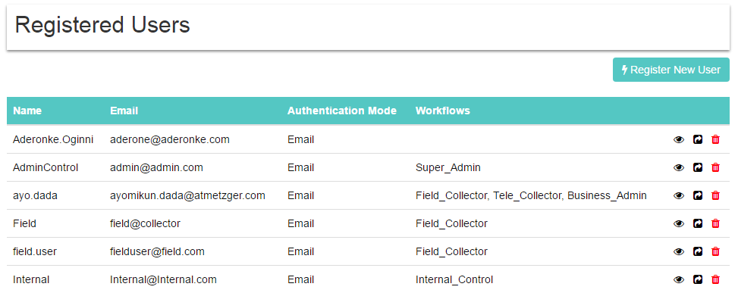
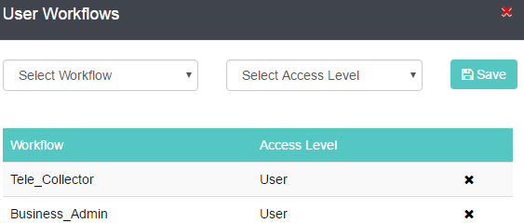
MetCore: Dashboard, Workflows & Reports
Audit trail, Register Users & User Workflows
Audit Trail | Details all logged activities of system users (activity, machine no., IP address)
Register Users | Register users, using Active Directory or email
System Messages | Add/Assign user to different roles/access levels
RC: 1031898

Slide 41
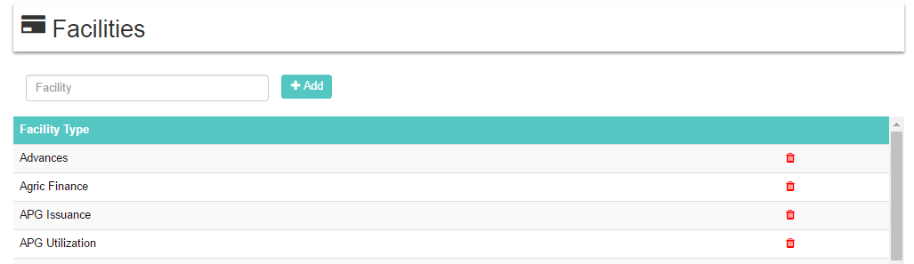
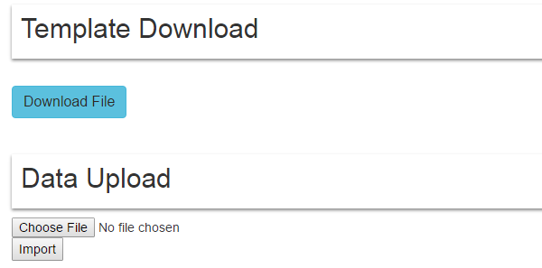
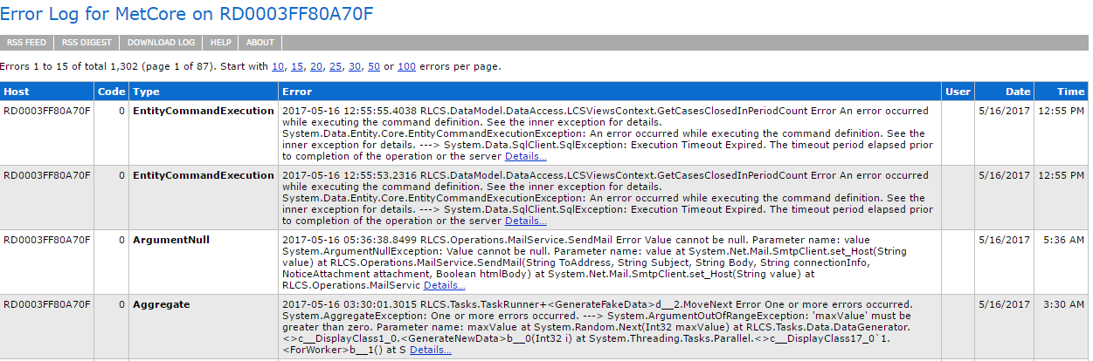
Met Core: Dashboard, Workflows & Reports
Facilities, Data Upload & Error Logs
Facilities | Manage credit/loan facilities available on system
Data Upload | Interface for uploading files for automatic system data entry
Error Log | Manages and logs all System Errors/Crashes for Debugging
RC: 1031898

Slide 42
value
proposition

Slide 43
Value Proposition
METCORE is a hosted solution built on enterprise-class software interfaced with a large, pre-existing agency and legal network.
METCORE is capable of being updated along with changing situations on the fly. Collections firms will be empowered in their ability to support champion/challenger, strategies to test and validate work stream improvements. Thus, significantly assisting in adhering to legal and compliance requirements.
Improved Productivity And Real-time Dashboarding will enable supervisors to provide appropriate feedback to collectors to make certain that Key Performance Indicators (KPI) goals are met on a regular basis. The resources in need of coaching or training can be identified and collectors that excel can be provided with timely and accurate positive reinforcement.
RC: 1031898

Slide 44
Value Proposition
All transactions including adds, movements, updates and retirements are recorded in an easily accessible table. This fundamental control provides not only an appropriate accountability and audit trail but the opportunity to review and approve transactions prior to their effecting the database.
METCORE enhances process performance through enabling your organization to be more efficient through automating many of your manual processes, freeing your staff to devote their time to higher value activities.
Manage cash flow with easy techniques and tools by eliminating unnecessary expenses, and enforce payment discipline of the debt collection process with automated notifications of overdue payment.
RC: 1031898

Slide 45
Critical Success Factors
Introduce METCORE Application and ensure maximum compliance (high penalties for unauthorized truck movements within the Port access roads
Buy-in and acceptance by Collectors, Risk Managers and Risk Divisions/Departments
The METCORE Application should integrate with most existing data applications and multiple storage protocols
RC: 1031898

Slide 46

Summary of Benefits
STAKEHOLDERS | BENEFITS
Client | System flexibility in providing alternative Collections strategies that can give temporary respite, enabling once profitable customers to manage in the short to mid term Speed of deployment in configuring and deploying a system that effectively tackles Collections priorities in as less than 4 months Reduced Total Cost of Ownership leading to lower cost of delivery, lower cost to collect and decreased recovery windows Scalable and Flexible solutions Meet your changing demands and streamline collection processes from early arrears to litigation
RC: 1031898

Slide 47



Summary of Benefits
STAKEHOLDERS | BENEFITS
Risk Managers | Ability to expected payments to track expected payments in addition to providing a statistical cash forecast for more accurate cash flow management. Ability to reduce bad debt write-offs by as much as 15-25% because outstanding cases can be identified and disputes resolved sooner, preventing them from aging to the point where they’re uncollectable. Enhanced decision making through the availability of comprehensive reporting tools and Management Information Systems (MIS)
Supervisors | Leverage team strengths in the management and allocation of case management duties
Litigators & Supervisors | Fully integrated litigation and recovery functionality ensure that all strict legal and regulatory processes are followed and that workflow between all parties involved is automated, minimizing errors.
RC: 1031898

Slide 48



Summary of Benefits
STAKEHOLDERS | BENEFITS
Auditors | System Audit Log provides basic information to backtrack through the entire trail of events to its origin, including the user/process responsible for the original creation of the record System Audit Trail assists Compliance Auditors in analyzing and review of business processes
Collectors | Increased workflow productivity in factories, and increase in the number of import/export cycles Increased efficiency through automation of manual processes
Debtors | Ability to improve borrowing positions by enhancing their credit ratings through diligent adherence to system reminders when PTPs are due Presence of a real-time dashboards and follow-up reports to review historical data, visits and PTPs collected
RC: 1031898

Slide 49
Next Steps
Execute MOU with Client
Agree way forward and modalities
Obtain approvals
Develop implementation roadmap
Demonstrate METCORE System capabilities to stakeholders
Engage stakeholders, develop and build strategic model and assess change readiness
Execute change management plan
Deploy platform and provide ongoing support
RC: 1031898

Slide 50
Next Steps
Execute MOU with Client
Agree way forward and modalities
Obtain approvals
Develop implementation roadmap
Demonstrate METCORE System capabilities to stakeholders
Engage stakeholders, develop and build strategic model and assess change readiness
Execute change management plan
Deploy platform and provide ongoing support
RC: 1031898

Slide 51
thank you!
Contact Us
Address: 114 Herbert Macaulay way, Ebute-Metta East, Yaba. Lagos
Tel: (+234) 0802295153
Web Site: www.atmetzger.com
E-mail: info@atmetzger.com
www.metcore-app.azurewebsites.net

